Slide 1
College Sports and Covid-19
Kristine Dinh

Slide 2
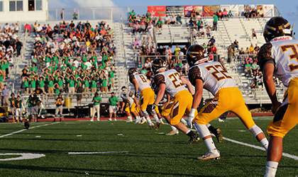
Introduction
Name: College sports and Covid-19. It’s complicated
Written by Sheldon Jacobson
Written on October 01, 2020

Slide 3
Problem/Challenge
Universities had to cancel winter sports
The risk of playing vs not playing
Myocarditis – the heart is weakened by virus infections

Slide 4
Data Analysis
CDC data from 3/20 to 5/20
75,000 confirmed cases among 18-24 men
450,000 infections in this group (6:1)
15 million people in this age group
3% infection rate
67 Covid-19 deaths in male 18-24 age group
130 college football teams in America
Each team has 100 players, on average
~13,000 football players

Slide 5
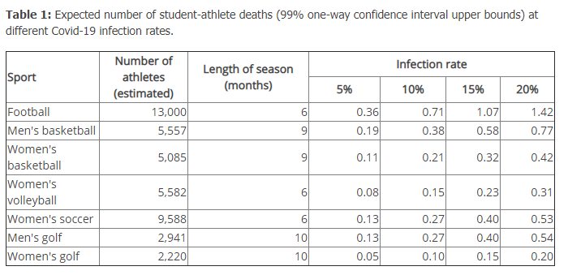

Slide 6
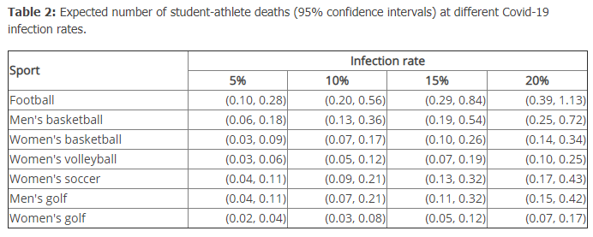

Slide 7
How the problem/challenge is overcome?
Keep students from becoming infected
If a students got infected, they should seek professional help immediately
Banned students who got infected from playing (at most 10/100)
Increase safety protocols

Slide 8
Additional challenges
The data is only from March to May 2020
The analysis is only for male

Slide 9
How the work can impact pandemic?
From 2010 – 2019, 42 football players died (non-Covid)
About 4 football players can die because of Covid
If infection rate can be low, college sports can continue

Slide 10
Key takeaways
Managing and mitigating risk
Find ways to avoid infection (teams bubble)
“Running away from risk often creates additional unforeseen problems.”

Slide 11
Reference
Jacobson, S. (2020). Significance magazine - College sports and Covid-19. It’s complicated | Significance magazine. Retrieved 25 November 2020, from https://www.significancemagazine.com/sports/686-college-sports-and-covid-19-it-s-complicated?highlight=WyJjb3ZpZCJd

